Slide 1
Behavioral Health Information Technologies and Standards (BHITS) II
Omnibus Care Plan
Administrator User Guide
Developed by FEI Systems for SAMHSA BHITS, September 2018

Slide 2
Contents
Introduction
Chapter 2: Manage Organizations
Chapter 3: Manage Practitioners
Chapter 3: View Patients
Chapter 4: Administrative Settings

Slide 3

Introduction: Omnibus Care Premise
Patient-centered care revolves around effective and efficient care coordination across care providers, patient engagement, social connectedness, and facilitating the patients’ treatment beyond episodic or chronic treatment.
Today, the healthcare environment is fragmented and ineffectual in providing 360⁰ whole-patient care with the mix of private and public insurers and self-pay with a large number of no-pay patients.
SAMHSA is devoted to the care and treatment of behavioral health patients. New models of paying for care are being developed and initiated with the objective to reduce the cost of healthcare.

Slide 4
About the Omnibus Care Plan
A patient-centric, standards-based, goal-driven treatment plan
Application through which the patient and his or her care team can communicate
Authoritative source for care planning
Synthesize, reconcile, and de-conflict patients’ data
Monitor patients’ data and monitor processes across health care institution boundaries
Real-time integrated view of an individual care plan
Includes structured and narrative information

Slide 5
Omnibus Care Plan Modules
Organization Administration Module–Adding and managing organization details, contact personnel, locations and activity definitions
Practitioners Module–Adding and managing practitioner details, practitioner roles and organization association
Patients Module–Adding and managing patient details, patient’s care teams (which include members across organizations, related persons and other patients) and patient’s insurance/benefits details
OCP Access Module–Register users to OCP and manage user access
Appointments and Scheduling Module–Creating appointments, appointment actions (accept, tentative, decline), calendar view, appointments panel and importing organization Outlook calendar into OCP
Tasks and To-Do Module–Creating, managing and updating patient-related tasks (based on organization defined activity definitions) and patient related To-Dos
Communications Module–Logging patient communications and associate communications with appointments, tasks and To-Dos
Care Planning Module–Creating and managing care plan in Quippe Clinical Lens
Screeners and Assessment Module–Patient screeners and assessments through bhworks CUBS assessment tool
Consent Management Module–Creating and managing patient’s consents through Consent2Share
SMART-on-FHIR Apps Management Module–Consent2Share, Quippe Clinical Lens & Designer, bhworks CUBS Assessment

Slide 6


Omnibus Care Plan Functional Overview
Administrative
Program, Services, Locations
Patient Enrollment
Practitioners, Organizations
Episode of Care
Care Coordination
Caseload Mgmt. Dashboard
Program Mgmt.
Screener/ Assessment
Scored screening and assessments (MA Assessment, PHQ9, PHQ4, etc.)
BH-Works Comprehensive Assessment
Care Planning
SOAP/Visit Notes
Outreach/ Activity Management
Smart Notes
Dynamic Care Plan Summary
Scheduling/ Appointment
New Appointments
Encounter Management
Goals and Interventions based on Outcomes/scores
Patient Consent
Computable Scores/sub-scores (LOINC)
Enrollee/ Consumer Dashboard
Standards-based Data Shared Among Applications

Slide 7
Omnibus Care Plan Portal and Users
OCP Admin
Onboarding of organizations to OCP and adding practitioners to OCP
Managing roles/users in UAA and Helpdesk/Troubleshooting
Org Admin
Managing organization locations, healthcare services, activity definitions
Associating practitioners to organization/location and assigning roles
Care Manager
Manage patient information, care teams, and assign care coordinators
Patient consents
Care Coordinator
Tasks, To Do, Appointments, Communication, Assessments
Care Coordination activities and care plan management
Patient
Other Possible Functional Roles
Similar Care coordination activities for Benefits specialist, Front Office, Health Assistant, and so on
Patient information, Care Team
Business Function Role
High-level Responsibilities
Appointments, Communication, Consents

Slide 8
About the Omnibus Care Plan User Guides
The Omnibus Care Plan User Guides will provide information about how different users navigate the Omnibus Care Plan, and more:
Omnibus Care Plan Administrator User Guide
Organization Administrator User Guide
Care Manager User Guide
Care Coordinator User Guide
SMART on FHIR Applications

Slide 9
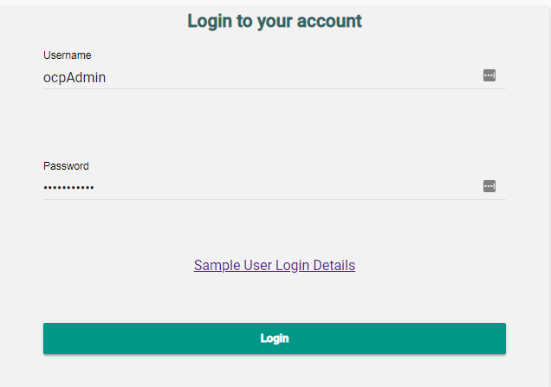
Role of the Omnibus Care Plan Admin
Creating Org Admin roles and users–Assigning an Organization Administer User
Creating permission groups–Creating and Managing permission groups
Registering SMART-on-FHIR apps–Registering and Managing SMART on FHIR Applications

Slide 10
Omnibus Care Plan Admin Login Page
Login using OCP Admin credentials

Slide 11
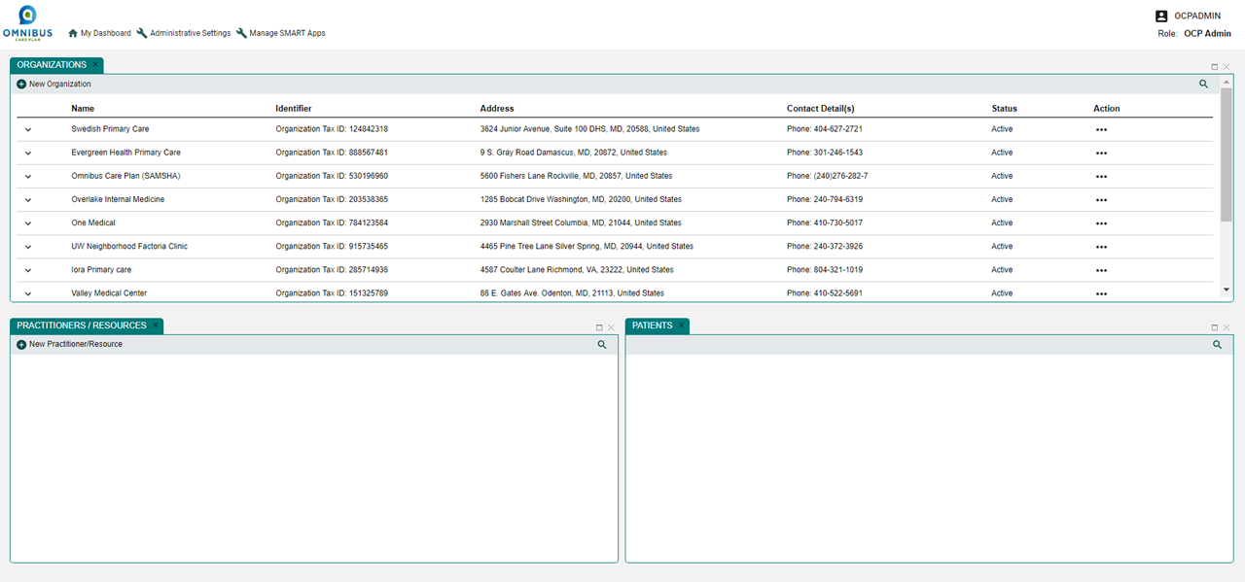
Omnibus Care Plan Admin Dashboard
Top: My Dashboard, Administrative Settings, Manage Smart Apps
Panels: Manage Organizations, Practitioners/Resources, and Patients

Slide 12
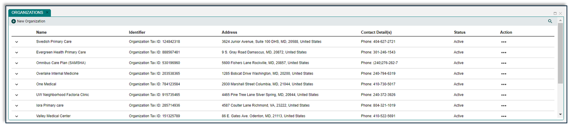
Chapter 1: Manage Organizations
This chapter will illustrate how an OCP Admin can:
Add organizations to the Omnibus Care Plan
Add Organization Details and Contact Personnel to Omnibus Care Plan Database
Edit organization’s services, locations, and activity definitions
Edit and Update Organization Details, Services, Locations and Activity Definitions.

Slide 13
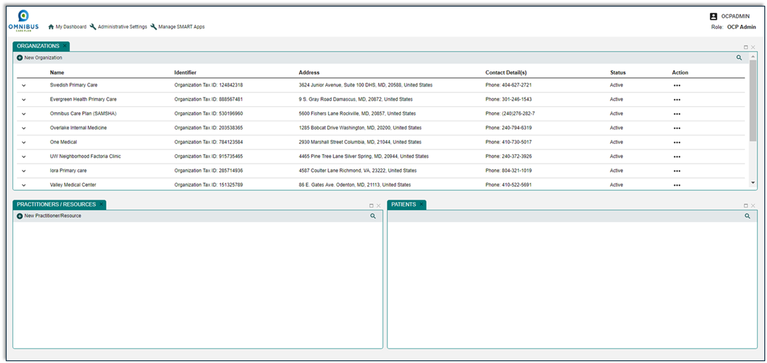
Manage Organizations
Click “New Organization” icon
Notes:
This is a screen shot from Demo. Use screen shot from QA environment for this slide.

Slide 14
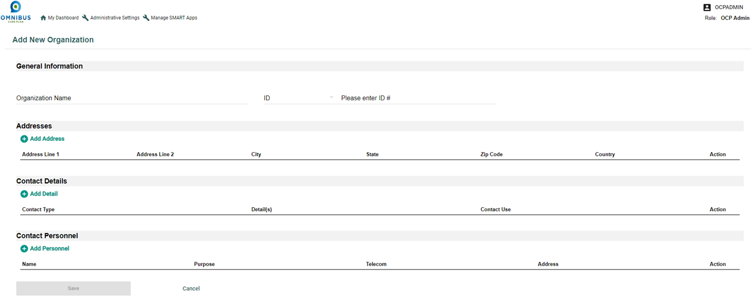
Add Required Organization Information
Add organization information in the relevant fields
After typing an entry, the “Required Fields” are identified in red

Slide 15
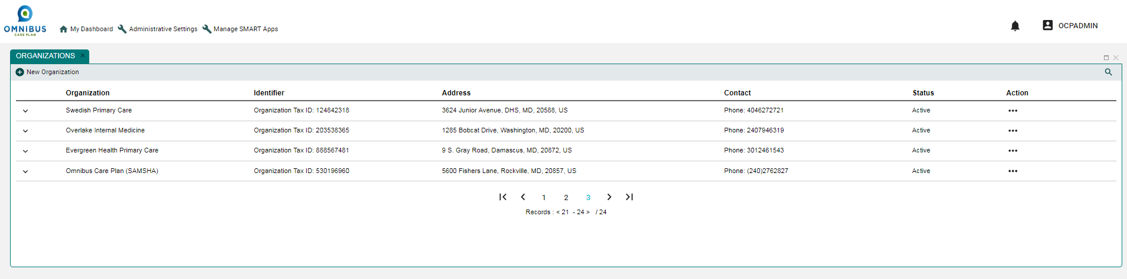
Review Organization Information
Click Chevron to review Organization you created
Notes:
This is a screen shot from Demo. Use screen shot from QA environment for this slide.

Slide 16
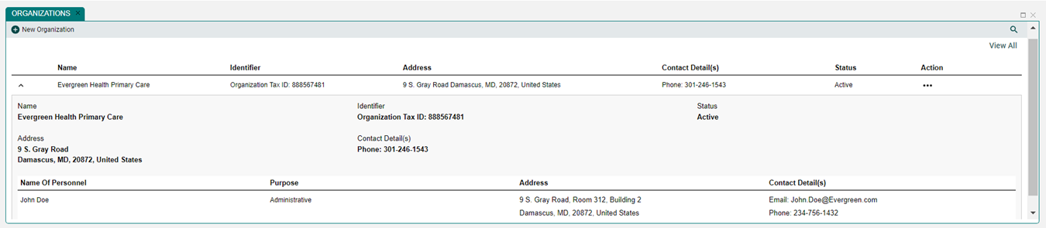
Edit Organization Information
After clicking Organization chevron, a Review and Edit window opens (User Evergreen Organization, it has organization personnel details also)
The Practitioner and Patient panels are context driven. Clicking on any organization will populate these panels.
Click on View All on Organizations Panel to see all organizations again.
To edit Organization, first click Action ellipses

Slide 17
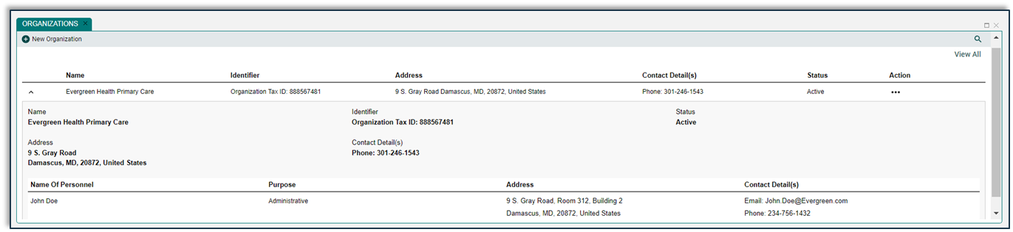
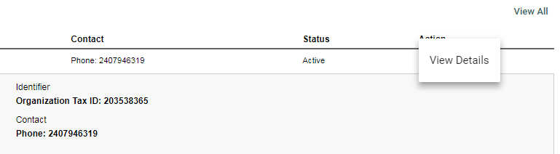
Review and Edit Organization Information
After clicking Action ellipses, the View Details button appears
To edit, click View Details action ellipses
1
2

Slide 18
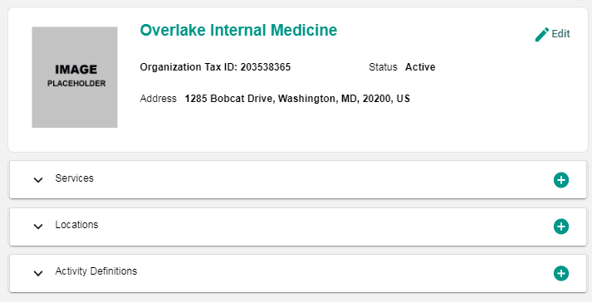
Review Organization Information
After clicking View Details, Slider Panel opens
Click chevrons for quick review of Services, Locations, and Activity Definitions

Slide 19
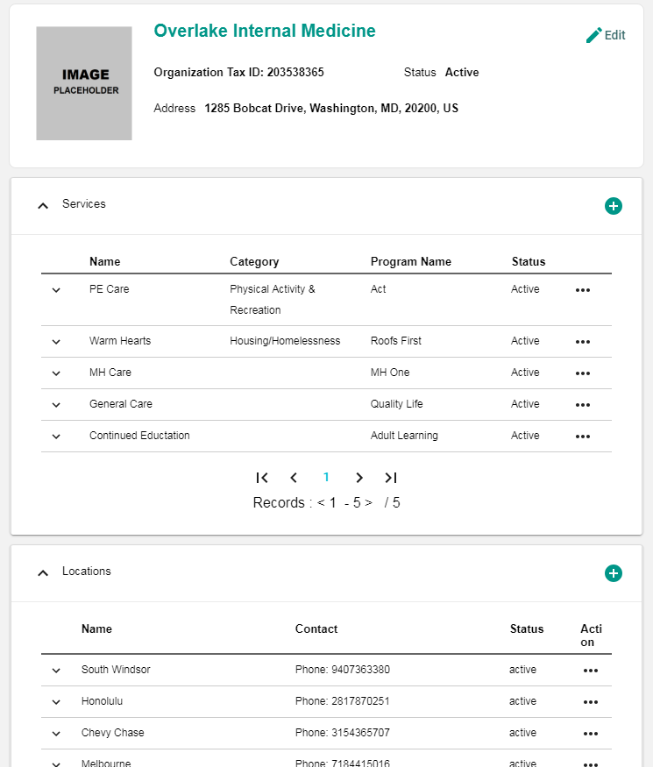
Quick Review of Organization Information
After clicking chevrons for Services, Locations, and Activity Definitions, details emerge for review

Slide 20
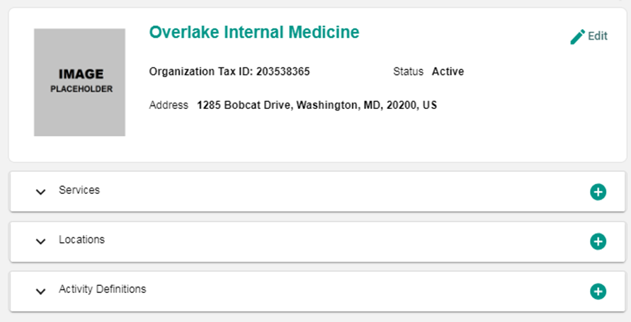
Edit Organization Information
To edit organization information, first click the Edit icon on the Slider Panel

Slide 21
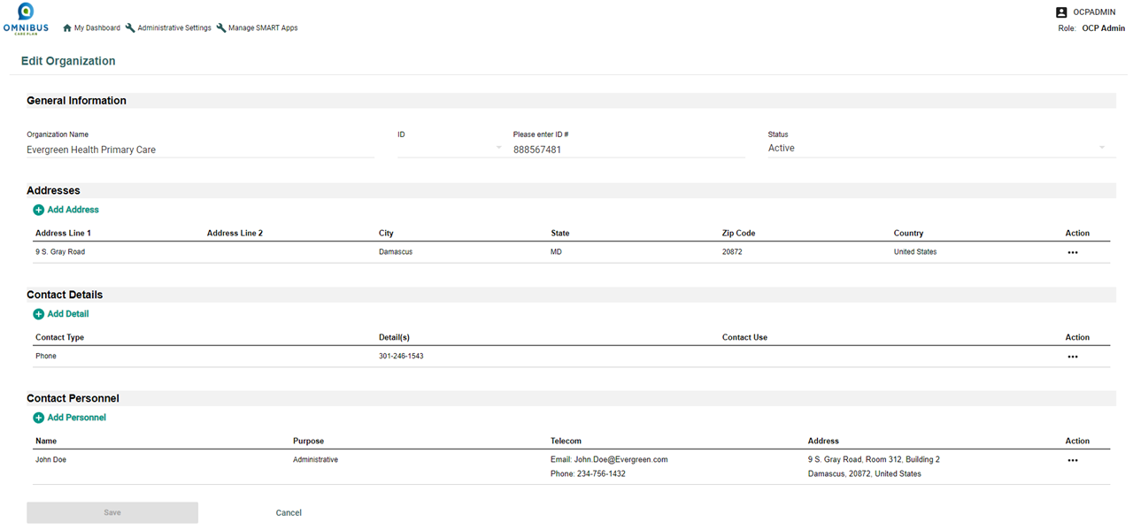
Update Organization Page
After clicking Edit icon, the Update Organization page opens
You can edit an Organization Here. Click Save when done.

Slide 22
Chapter 2: Manage Practitioners
This chapter will illustrate how an OCP Admin can:
Add a new practitioner to the Omnibus Care Plan
Enter required practitioner information
Search and add organizations
Add practitioner to practitioner list
Review added practitioner
Edit practitioner

Slide 23
Select New Practitioner Icon
Click New Practitioner icon

Slide 24
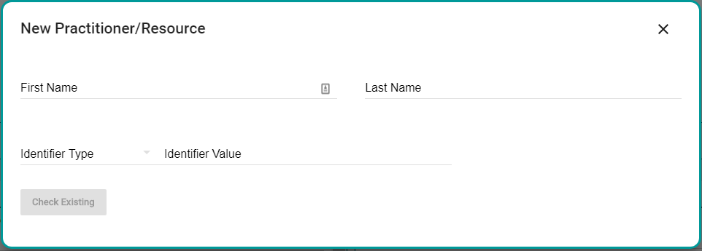
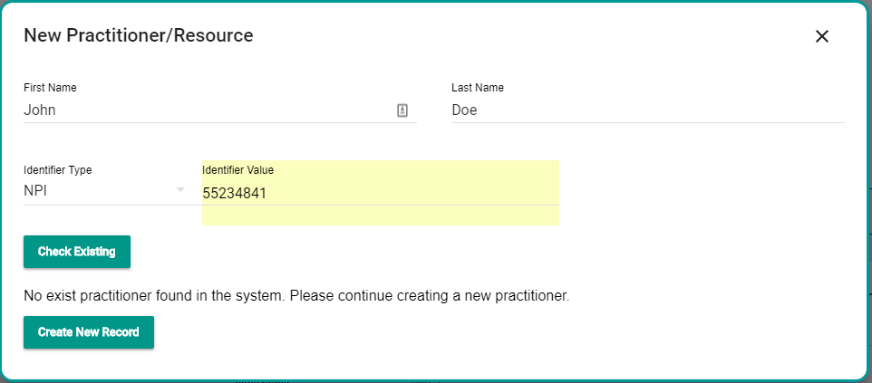
Check for Existing Practitioner
Check for Existing practitioner
If Practitioner not in OCP Database:
Enter details and click the check existing tab.
If the practitioner doesn’t exist create new record.

Slide 25
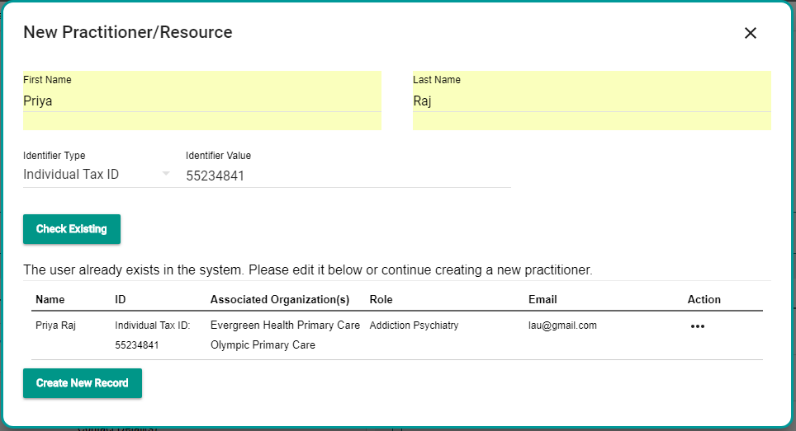
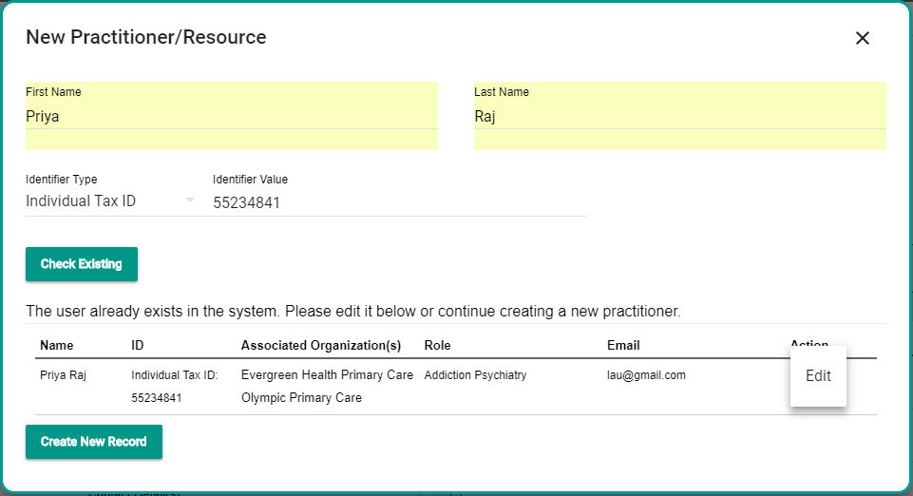
Check for Existing Practitioner
Check for existing practitioner
If practitioner exists in OCP Database, edit existing practitioner or select cancel to avoid duplicate

Slide 26
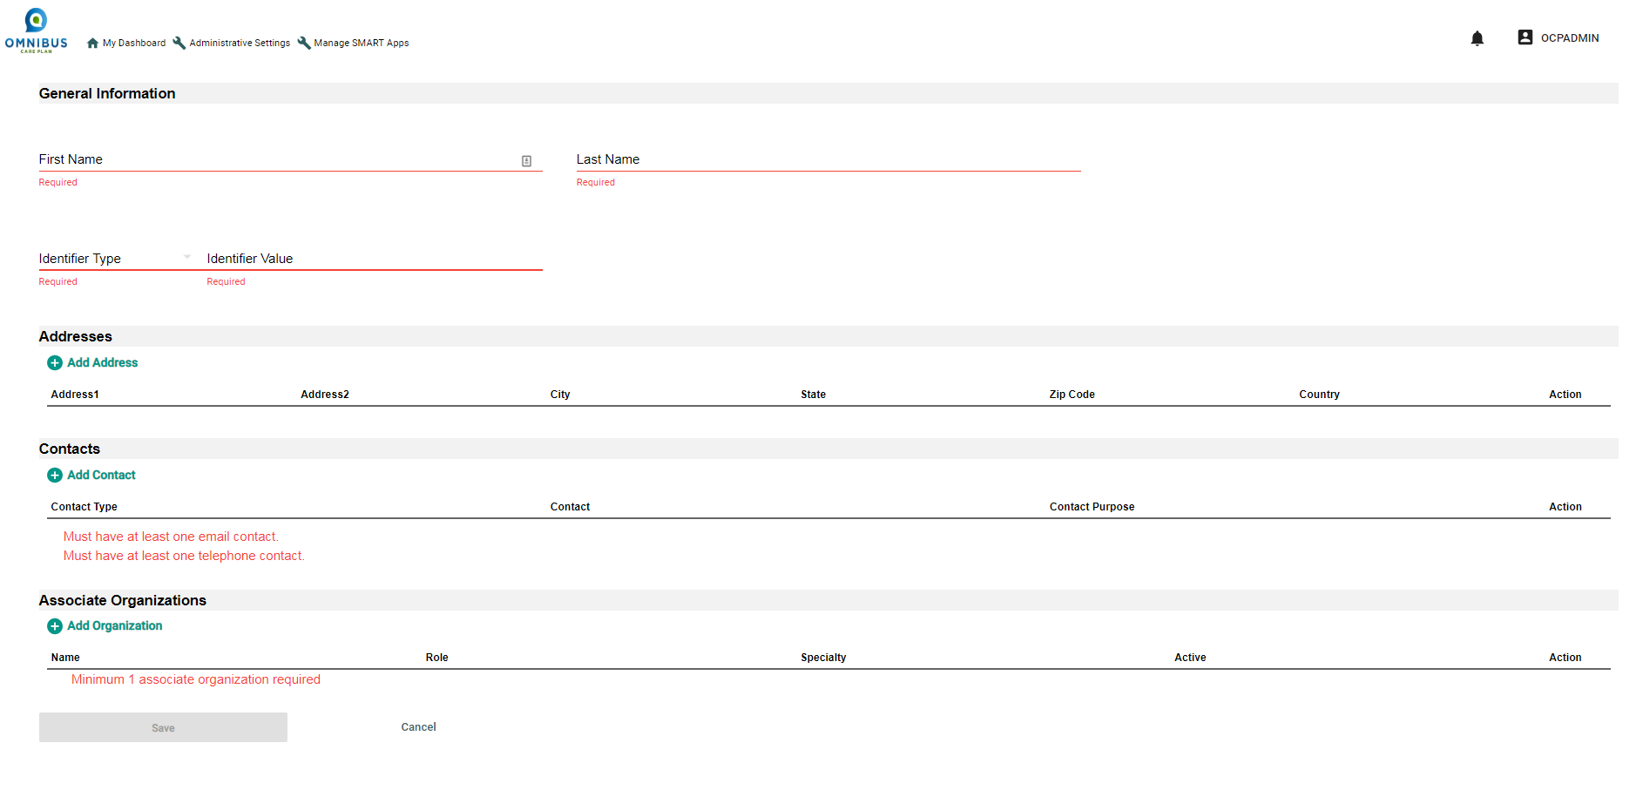
At Add New Practitioner Page, Enter Required Fields
Enter required fields

Slide 27
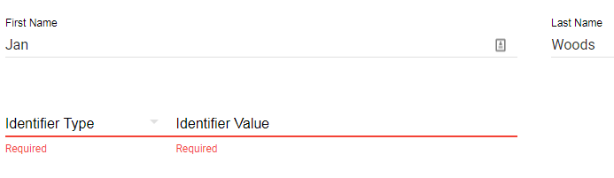
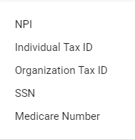
Select Identifier Type
Enter required fields

Slide 28
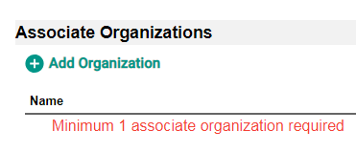
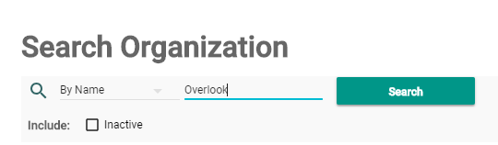
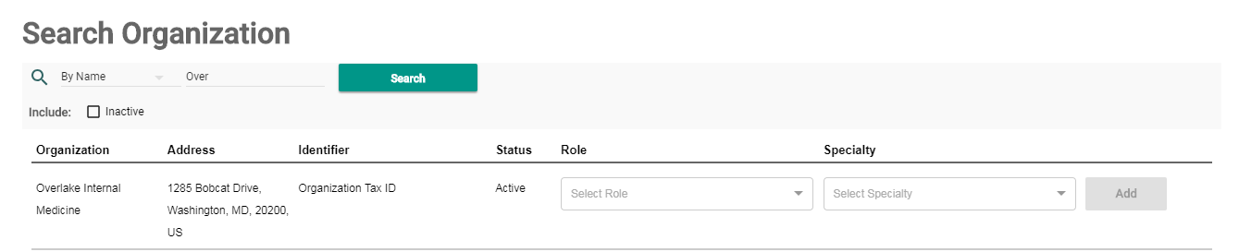
Search and Add Organization
Practitioner must be associated with an organization!
(1) Click Add Organization icon, (2) enter first three letters of organization and click Search, and (3) the organization populates
1
2
3

Slide 29
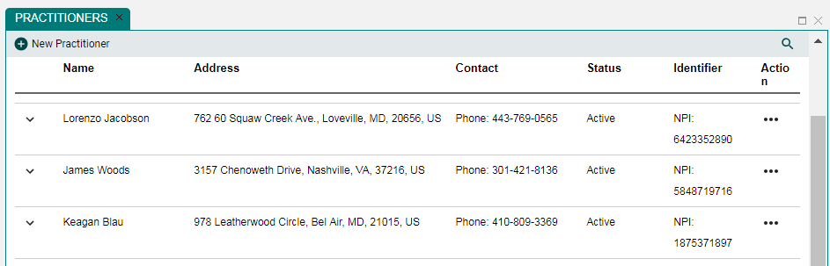
Practitioner is Added to Practitioner List
Once a practitioner is associated with an organization, it will display when the associated organizations is selected.

Slide 30
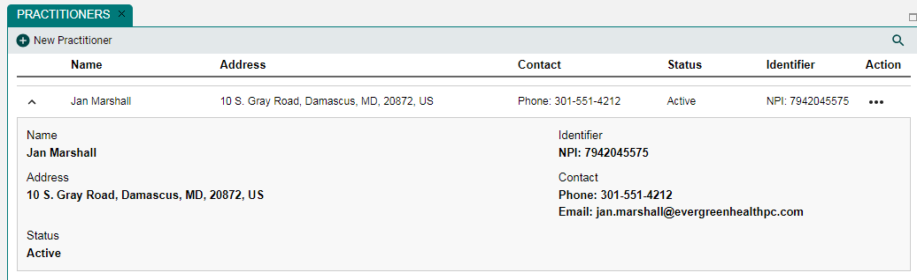
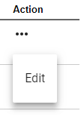
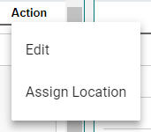
Edit Practitioner
Click Action ellipses to edit practitioner
Notes:
Replace Image

Slide 31
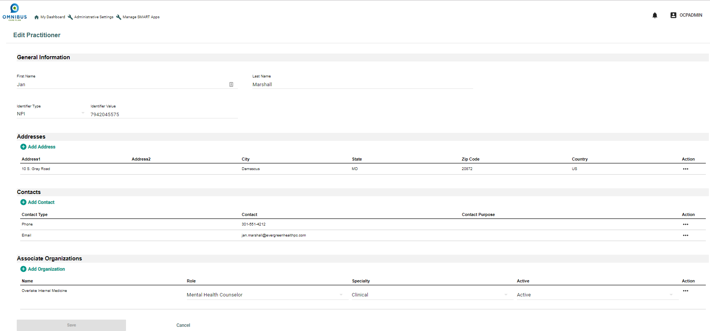
Edit Practitioner
After you click Edit, the Edit Practitioner page opens

Slide 32
Chapter 3: View Patients
This chapter will illustrate how an OCP Admin can:
View patient details
Note: An OCP Admin cannot edit patients

Slide 33
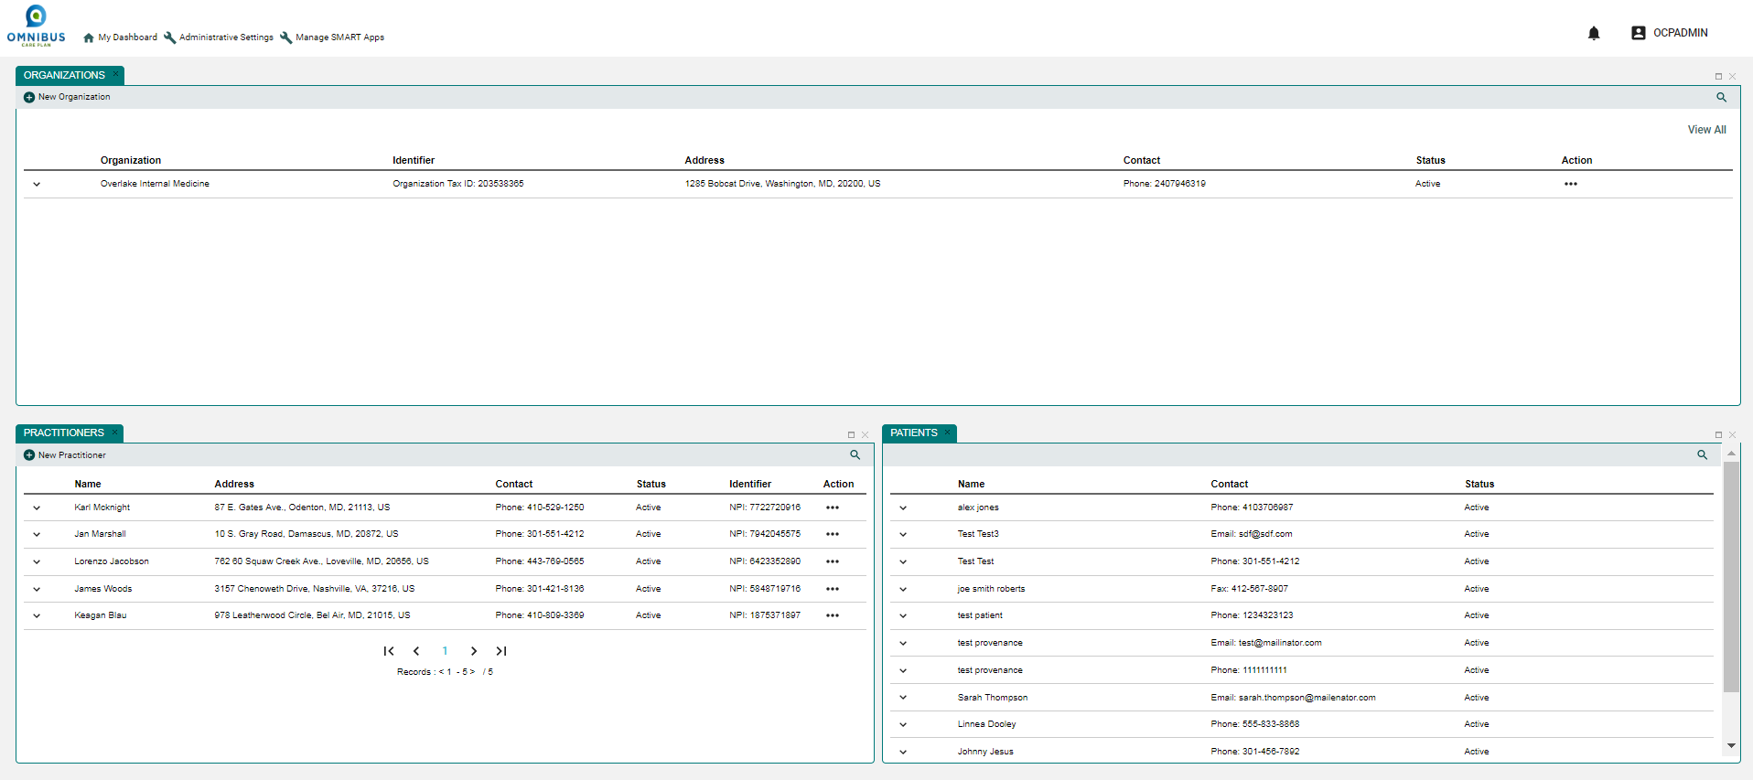
Chapter 3: View Patients
Click to select an organization in the Organizations Panel
The patient panel shows only patients managed by the selected organization
Notes:
This is a screen shot from Demo. Use screen shot from QA environment for this slide. The columns on patient panel are different.

Slide 34
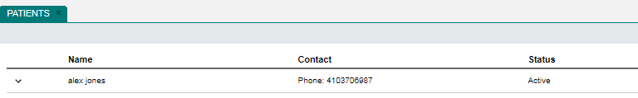
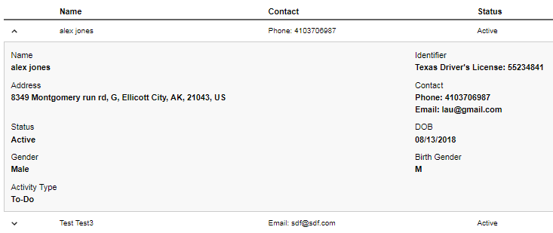
View Patients
Click chevron for patient and patient profile opens

Slide 35
Chapter 4: Administrative Settings
This chapter will illustrate how an OCP Admin can:
Create Permission Groups
Update Existing Permission Group
Manage OCP User Panel–Search Practitioner
Manage OCP User Panel–Search Patient
Create User Access–Practitioner (Search Juan Schroeder and select Olympic Care)
Manage User Settings–Practitioner (Search Juan Schroeder and select Evergreen)
Create User Access–Patient (Search Arya Stark)
Manage User Settings–Patient (Search Sally Share)

Slide 36
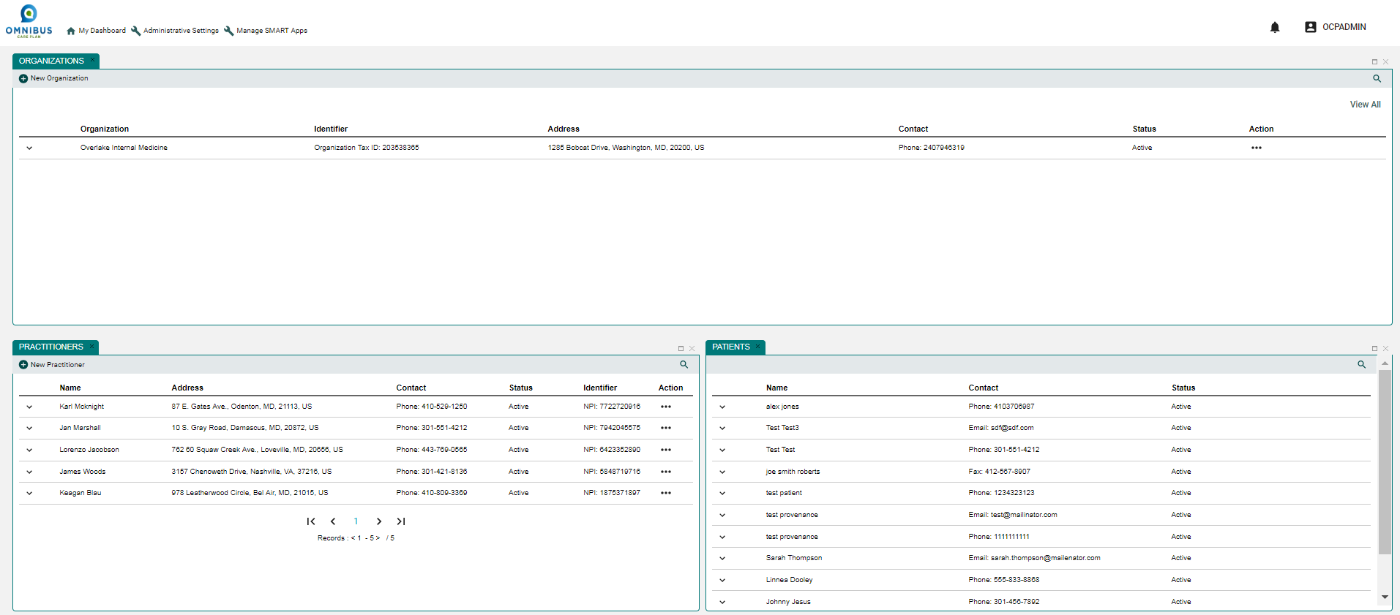

Administrative Settings
Click Administrative Settings link

Slide 37
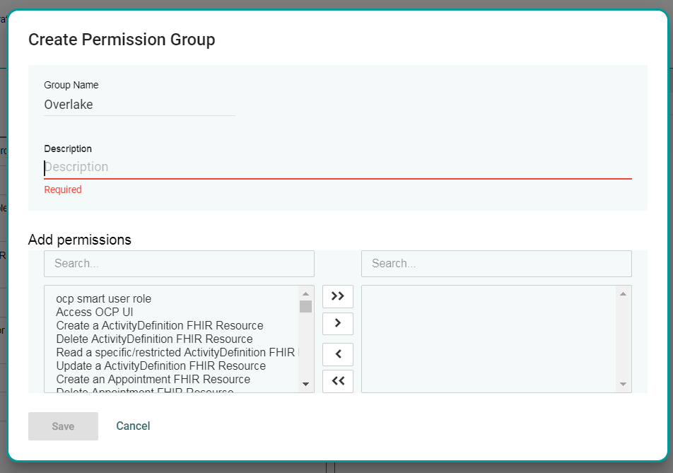
Create Permission Group
When you first open the Permissions Group page, it will be populated with a list of Permission Groups, such as Patient, Care Coordinator, Primary Care Provider, and so on.
The Permissions Groups page allows users to be assigned roles, such as patient, practitioner, organization administrator, and so on.
The Permissions Groups page also allows the OCP Admin to create a new custom permission group

Slide 38
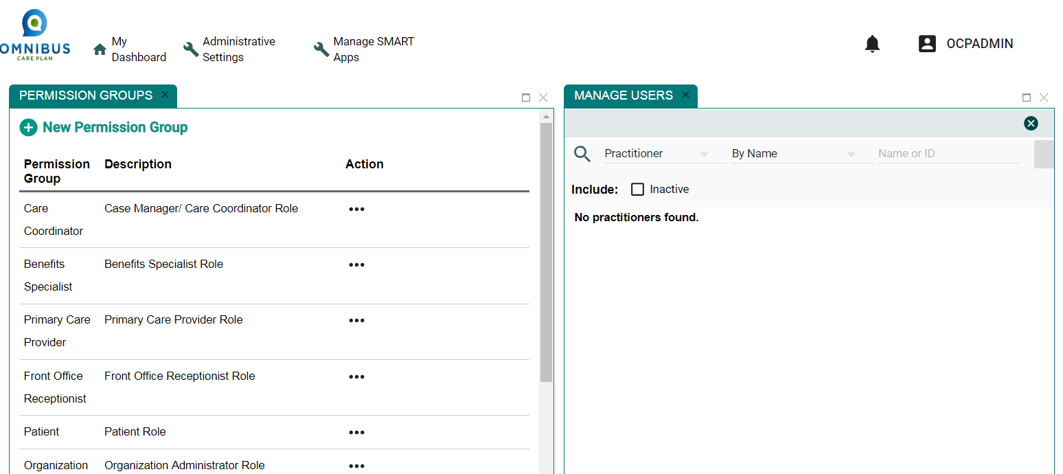
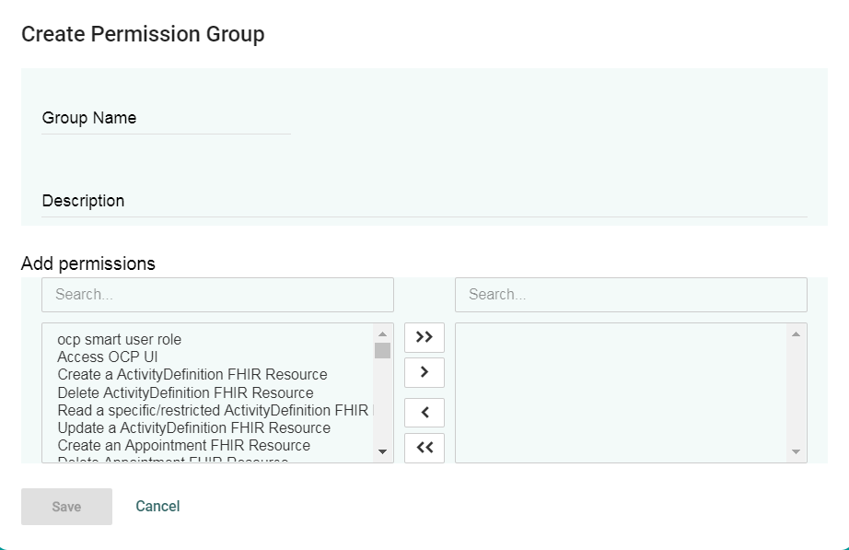
Permission Groups Panel: Create Permission Group
Select the New Permission Group icon.

Slide 39
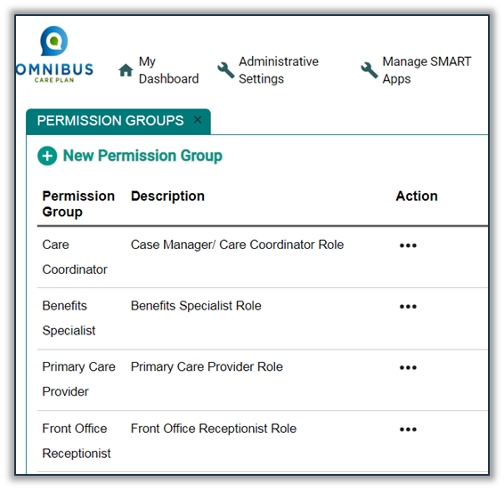
Permission Groups Panel: Create Permission Group
To create a new Permission Group, enter the Group Name and Description
Next, search and select permissions to be added to the panel on the right
When done, click the Save button
This new group will be automatically added to the list of Permission Group

Slide 40
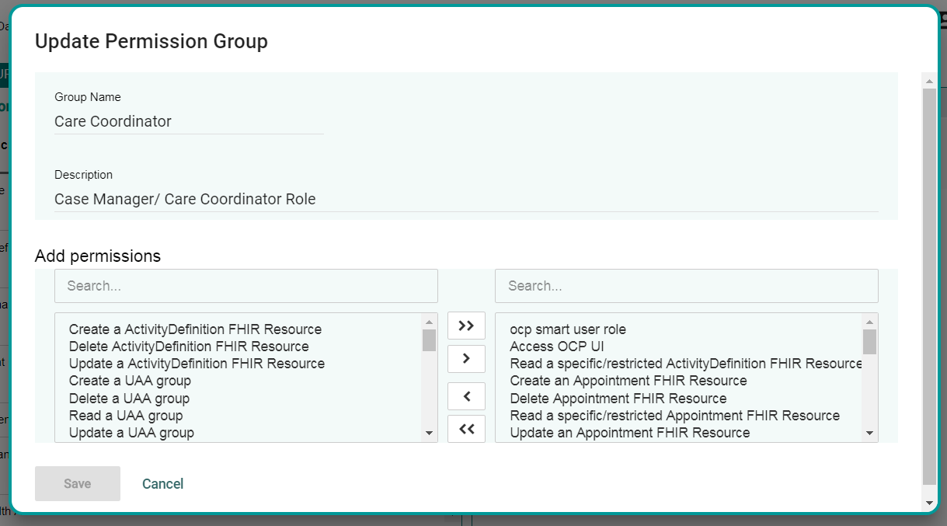
Update Permission Group Options
The Permissions Group page also allows the OCP Admin User to modify Permission Groups
After selecting Manage Group, the Update Permission Group page opens
Select the permission appropriate to the role
Add to pane on right
Click Save

Slide 41
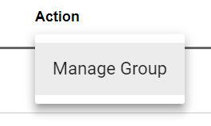
Permission Groups Panel: Update Group
Select Action ellipses. Manage group option opens.

Slide 42
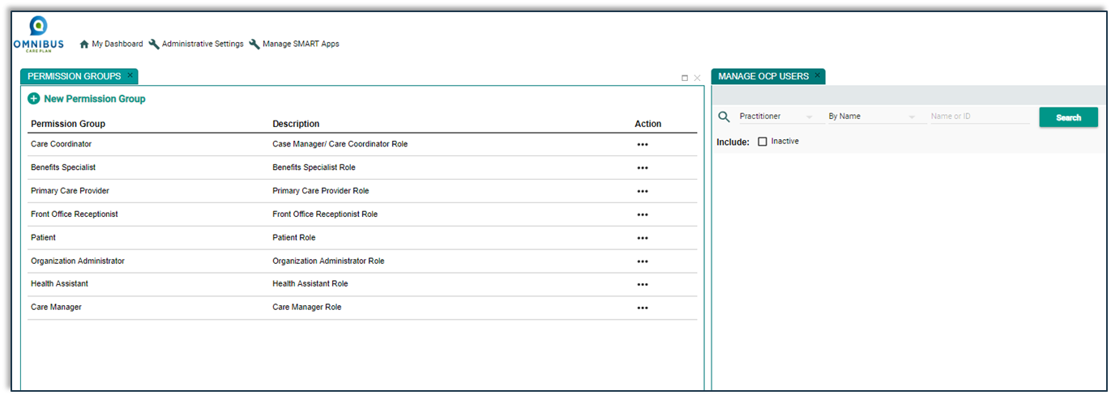
Manage OCP Users Panel
The Administrative Settings also allow the OCP Admin User to manage users permission by associating them to a Permission Group.
To begin, search for a practitioner or patient
Notes:
Please look at the latest changes: All slides following this slide will have some changes.

Slide 43
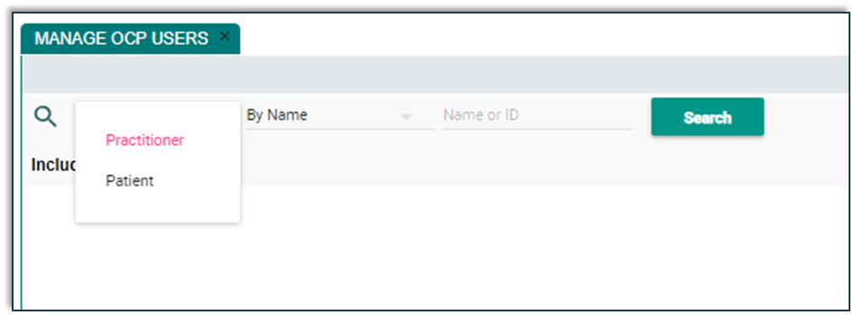
Manage Users Panel
Select Practitioner or Patient

Slide 44
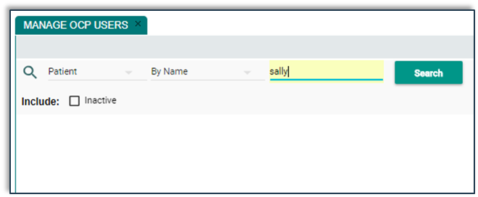
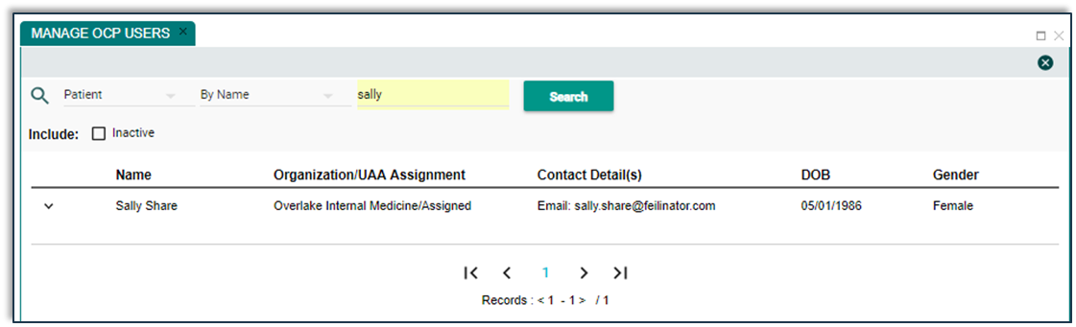
Manage Users: Search for Patient
Searched for Patient Sally. Finds Sally Share.

Slide 45
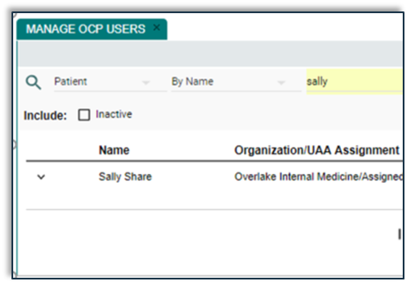
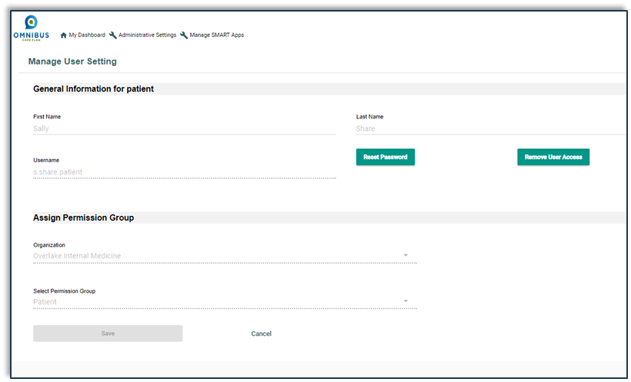
Manage Users: Patient User access page
Click anywhere on the row
Patient user settings page opens

Slide 46
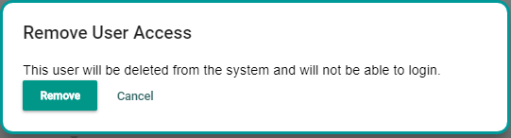
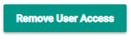
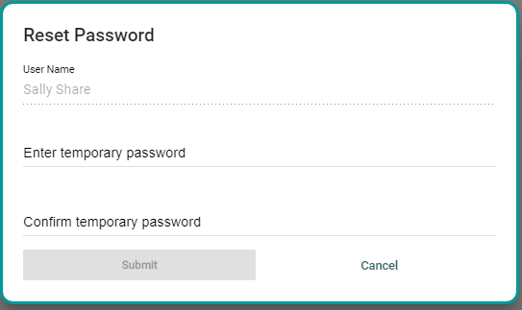
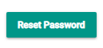
Patient: Remove User Access/Reset Password
Selecting Remove User Access will revoke the user from accessing OCP
The Reset Password option allows the OCP Administrator to create a temporary password to the user

Slide 47
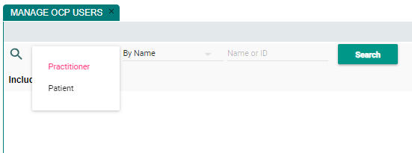
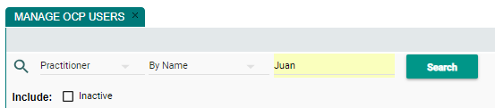
Manage Users Panel: Select Practitioner
Select Practitioner. Enter practitioner name. Click Search button.

Slide 48

Manage Users Panel: Search for Practitioner
Click the Search button. Results will display.

Slide 49

Manage Users Panel: View Practitioner Profile
Click chevron. Practitioner profile opens.

Slide 50


Manage Users Panel: Manage Practitioner
Click Action ellipses. Manage User option opens.

Slide 51

Manage Users Panel: Manage Practitioner
This practitioner is associated with two organizations.
Selecting Evergreen Health Primary Care brings you to the Manage User Settings page.
Reset Password and Remove user access can be performed here.

Slide 52

Manage Users Panel: Manage Practitioner
This practitioner is associated with two organizations.
Selection of Olympic Primary Care brings to Manage User Settings page.
User Registration to OCP can be done on this page.

Slide 53

Thanks!

